Slide 1
CSE 445 Lecture 10
Ensemble learning: Voting, Bagging & Pasting, Random Forest

Slide 2
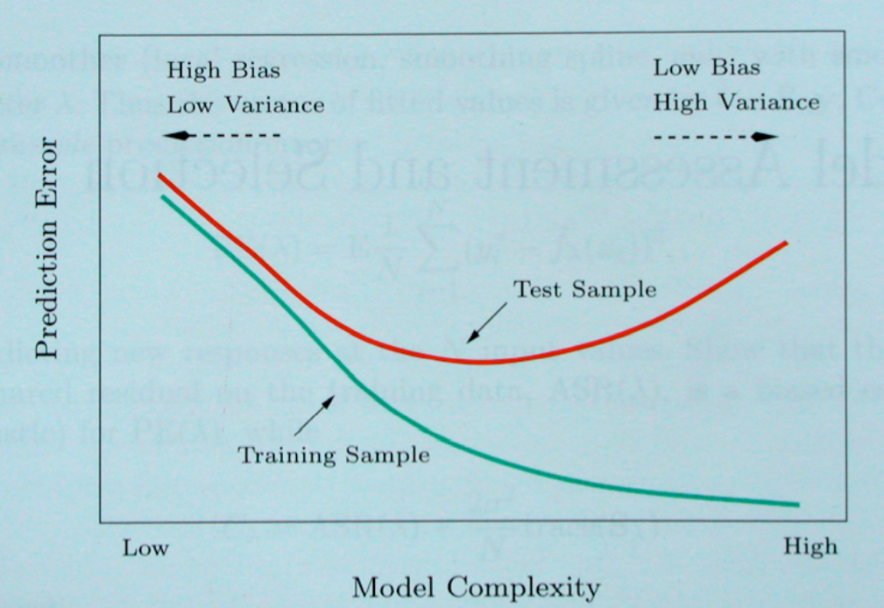
Bias/variance tradeoff
Bias/Variance tradeoff

Slide 3
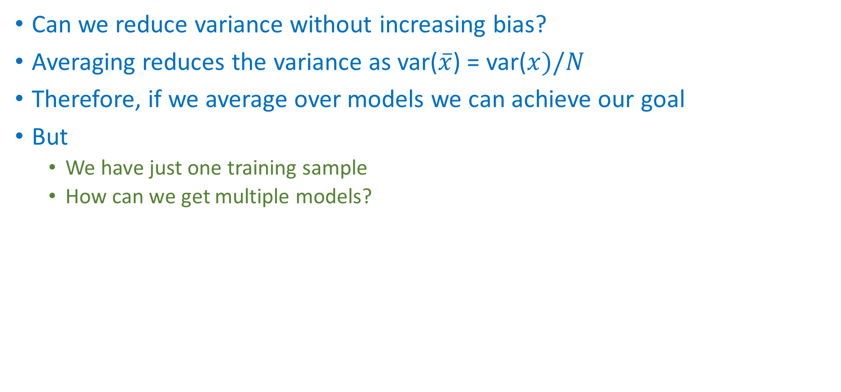
Bias/variance tradeoff
Can we reduce variance without increasing bias?
Averaging reduces the variance as var($\overline{x}$) = var($x)/N$
Therefore, if we average over models we can achieve our goal
But
We have just one training sample
How can we get multiple models?

Slide 4
Use different models: Voting classifiers
Suppose we have trained a few classifiers, each one achieving about 80% accuracy
For example, we can use a Logistic Regression classifier, an SVM classifier, a Random Forest classifier, a K-Nearest Neighbors classifier, and perhaps a few more
A very simple way to create an even better classifier is to aggregate the predictions of each classifier and predict the class that gets the most votes
This majority vote classifier is called a hard voting classifier

Slide 5
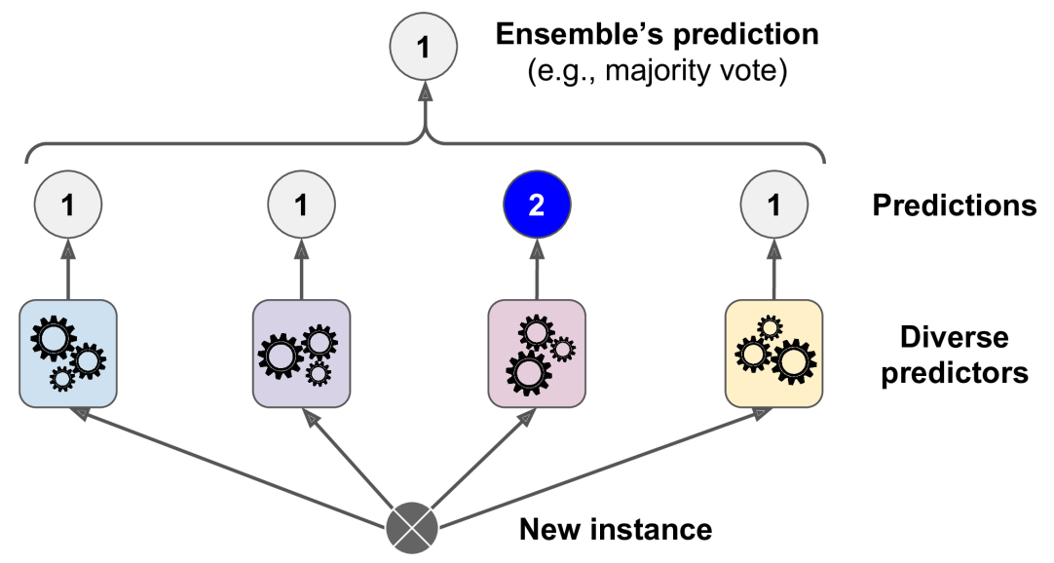
Hard voting classifier

Slide 6
Hard voting vs Soft voting
In hard voting (also known as majority voting), every individual classifier votes for a class, and the majority wins
In statistical terms, the predicted target label of the ensemble is the mode of the distribution of individually predicted labels
In soft voting, every individual classifier provides a probability value that a specific data point belongs to a particular target class
The predictions are weighted by the classifier's importance and summed up
Then the target label with the greatest sum of weighted probabilities wins the vote

Slide 7
Manipulate the dataset: Bootstrapping
In statistics, bootstrapping refers to a resampling method consisting of repeatedly drawn samples with replacement
Samples taken from the original data form smaller datasets, called bootstrapping samples
It’s as if the bootstrapping method is making a bunch of simulations to our original dataset
So in some cases we can generalize the mean and the standard deviation

Slide 8
Bootstrapping example
For example, let’s say we have a set of observations: [2, 4, 32, 8, 16]
If we want each bootstrap sample containing n observations, the following are valid samples:
n=3: [32, 4, 4], [8, 16, 2], [2, 2, 2]…
n=4: [2, 32, 4, 16], [2, 4, 2, 8], [8, 32, 4, 2]…
Since we drawn data with replacement, the observations can appear more than once in a single sample

Slide 9
Bagging & Pasting: sampling the dataset
One way to get a diverse set of classifiers is to use different training algorithms – as discussed for voting
Another approach is to use the same training algorithm for every predictor, but to train them on different random subsets of the training set
When sampling is performed with replacement, this method is called bagging (short for bootstrap aggregating)
When sampling is performed without replacement, it is called pasting
Both bagging and pasting allow training instances to be sampled several times across multiple predictors, but only bagging allows training instances to be sampled more than the original data

Slide 10
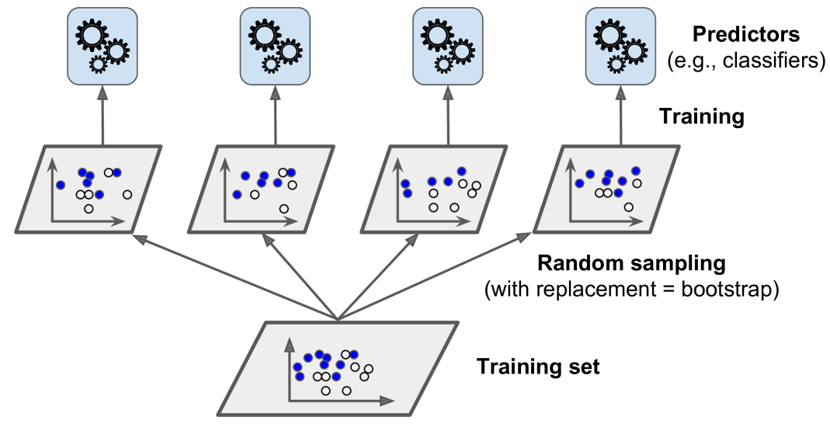
Bagging & Pasting

Slide 11
Bagging & Pasting: Prediction
Once all predictors are trained, the ensemble can make a prediction for a new instance by simply aggregating the predictions of all predictors
The aggregation function is typically the statistical mode (i.e., the most frequent prediction, just like a hard voting classifier) for classification, or the average for regression
Each individual predictor has a higher bias than if it were trained on the original training set, but aggregation reduces both bias and variance
Generally, the net result is that the ensemble has a similar bias but a lower variance than a single predictor trained on the original training set

Slide 12
Bagging & Pasting: Implementation
Scikit-Learn offers a simple API for both bagging and pasting with the BaggingClassifier class (or BaggingRegressor for regression)
The code on next slide trains an ensemble of 500 Decision Tree classifiers
Each trained on 100 training instances randomly sampled from the training set with replacement (this is an example of bagging, for pasting, set bootstrap=False)
The n_jobs parameter tells Scikit-Learn the number of CPU cores to use for training and predictions (–1 tells Scikit-Learn to use all available cores)

Slide 13
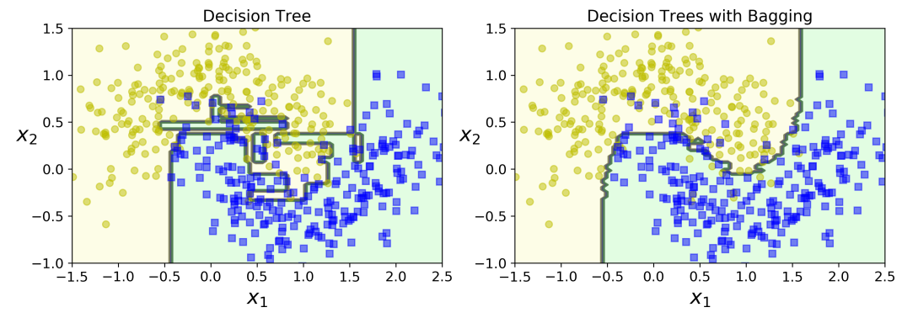
Bagging & Pasting: Implementation
from sklearn.ensemble import BaggingClassifier
from sklearn.tree import DecisionTreeClassifier
bag_clf = BaggingClassifier(DecisionTreeClassifier(), n_estimators=500,max_samples=100, bootstrap=True, n_jobs=-1)
bag_clf.fit(X_train, y_train)
y_pred = bag_clf.predict(X_test)

Slide 14
Bagging vs Pasting
Bootstrapping introduces more diversity in the subsets than each predictor is trained on, so bagging ends up with a slightly higher bias than pasting
This means that predictors end up being less correlated so the ensemble’s variance is reduced
Overall, bagging often results in better models, which explains why it is generally preferred
However, we can use cross validation to evaluate both bagging and pasting and select the one that works best

Slide 15
Out-of-bag scoring
If we are using bagging, there’s a chance that a sample would never be selected, while others may be selected multiple time
The probability of not selecting a specific row is (n–1)/n, where n is the number of samples
We are selecting one row out of n samples
Therefore, the probability of not picking n rows in n draws is (n–1/n)^{n}
When the value of n is big, we can approximate this probability to 1/e, which is approximately 0.3678. This means that when the dataset is big enough, 37% of its samples are never selected and we could use it to test our model
This is called Out-of-Bag scoring, or OOB Scoring

Slide 16
Random Forest
Random Forest is an ensemble of Decision Trees, generally trained via the bagging method (or sometimes pasting), typically with max_samples set to the size of the training set
Instead of building a BaggingClassifier and passing it a DecisionTreeClassifier, we use the RandomForestClassifier class, which is more convenient and optimized for Decision Trees
Similarly, there is a RandomForestRegressor class for regression tasks
The following code trains a Random Forest classifier with 500 trees

Slide 17
Random Forest Implementation
from sklearn.ensemble import RandomForestClassifier
rnd_clf = RandomForestClassifier(n_estimators=500, max_leaf_nodes=16, n_jobs=-1)
rnd_clf.fit(X_train, y_train)
y_pred_rf = rnd_clf.predict(X_test)
With a few exceptions, a RandomForestClassifier has all the hyperparameters of a DecisionTreeClassifier
To control how trees are grown
And, all the hyperparameters of a BaggingClassifier to control the ensemble

Slide 18
Randomness in building the Tree
The Random Forest algorithm introduces extra randomness when growing trees
Instead of searching for the very best features when splitting a node, it searches for the best feature among a random subset of features
This results in a greater tree diversity, which (once again) without trading a higher bias for a lower variance, generally yielding an overall better model

Slide 19
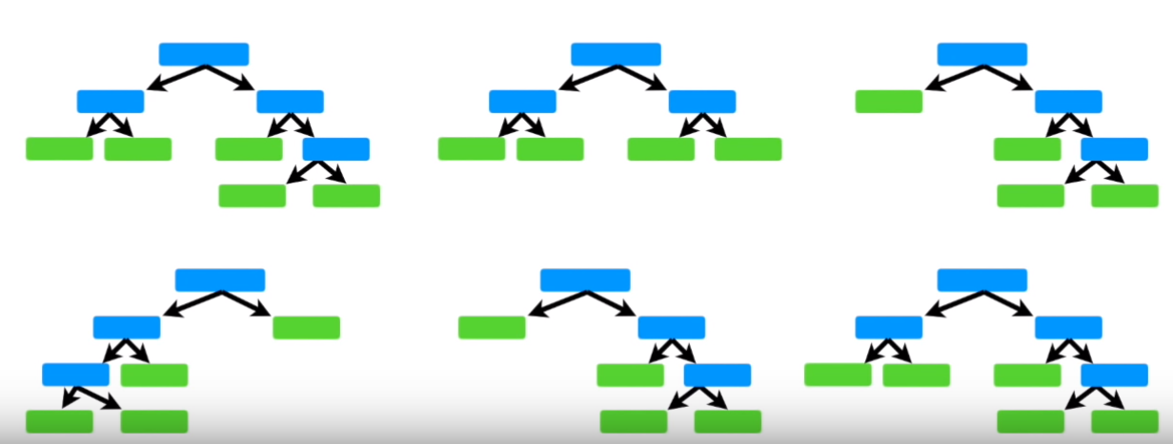
Random Forest: Building the model

Slide 20
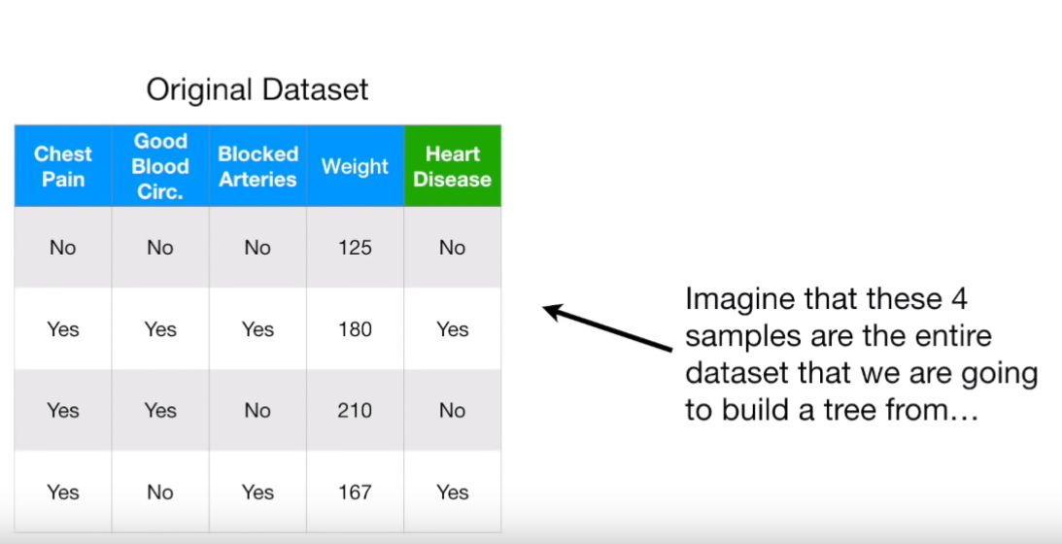
Random Forest: Building the model Create a bootstrap dataset

Slide 21
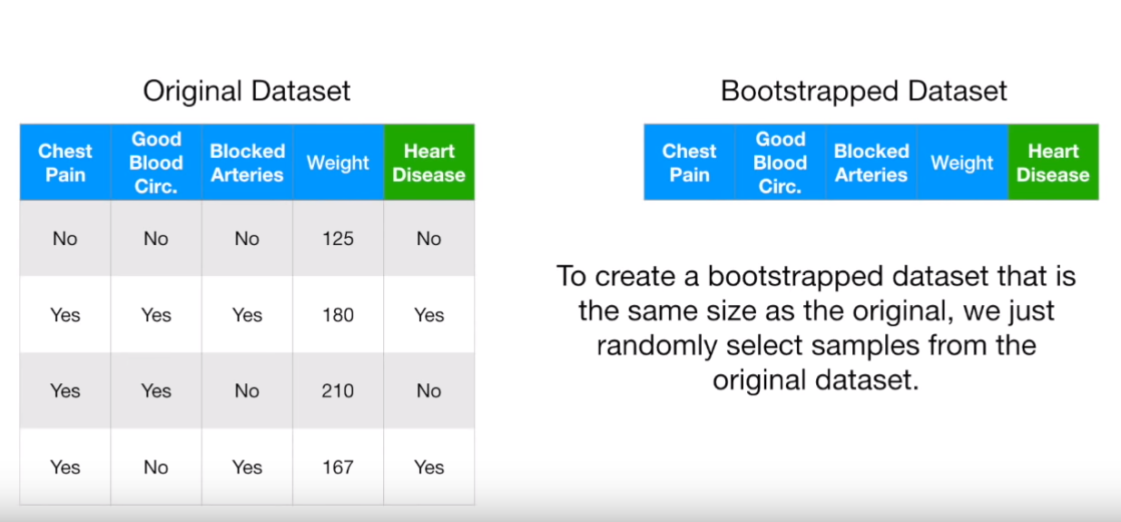
Random Forest: Building the model

Slide 22
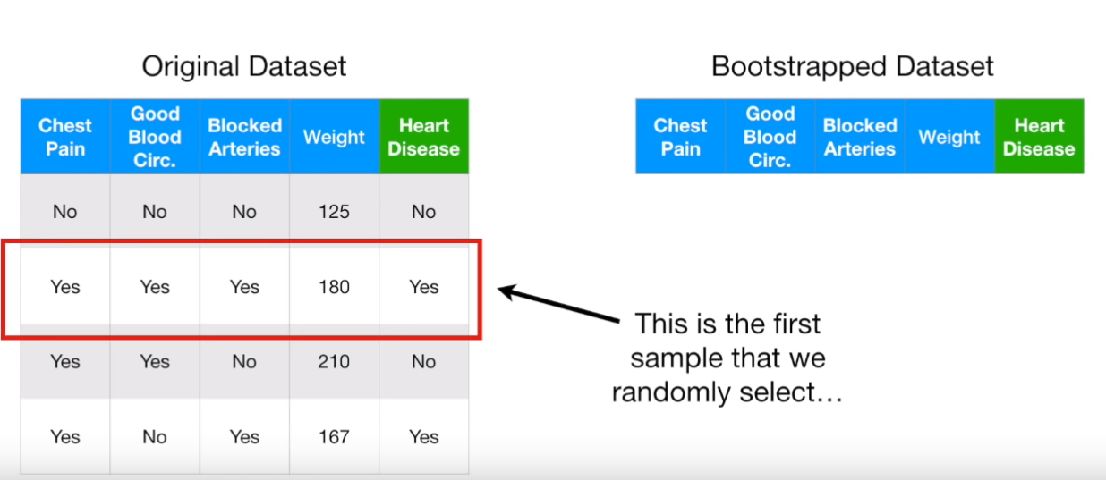
Random Forest: Building the model

Slide 23
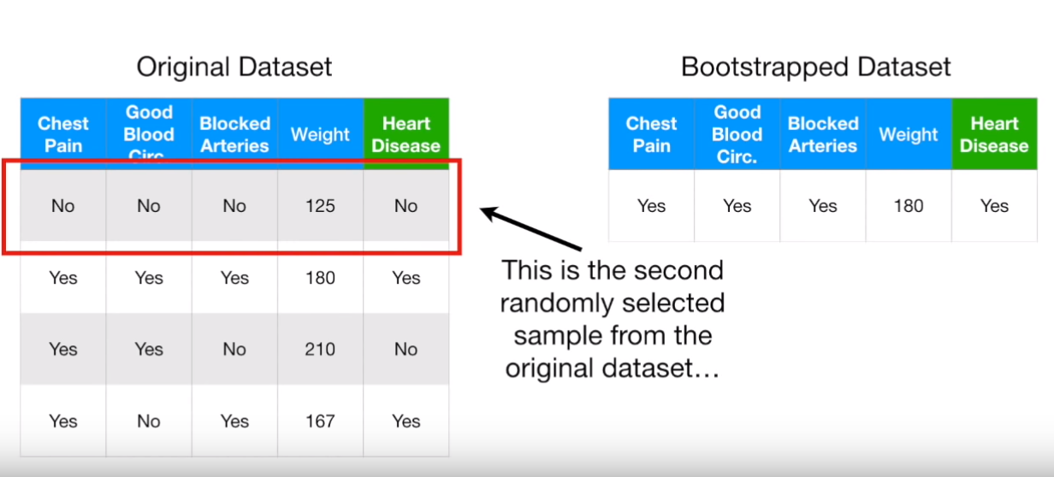
Random Forest: Building the model

Slide 24
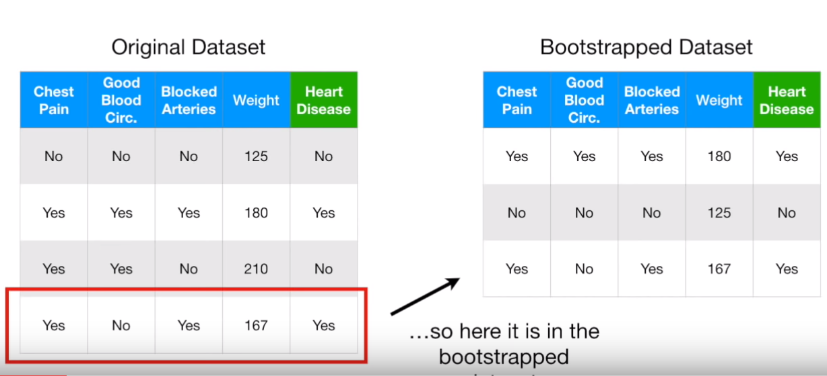
Random Forest: Building the model

Slide 25
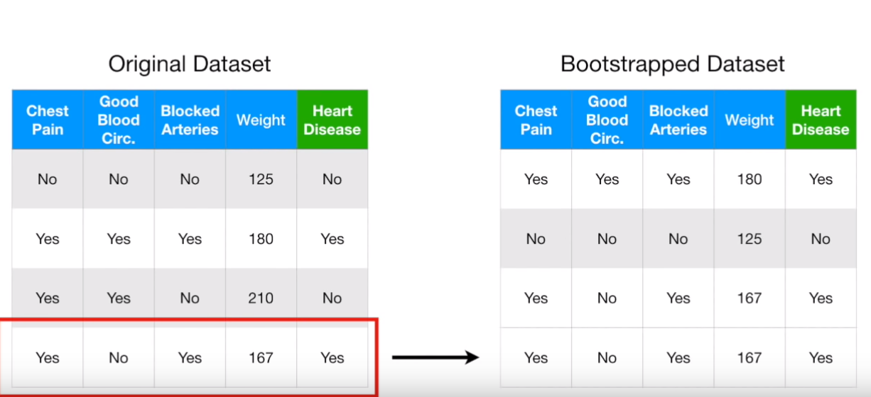
Random Forest: Building the model

Slide 26
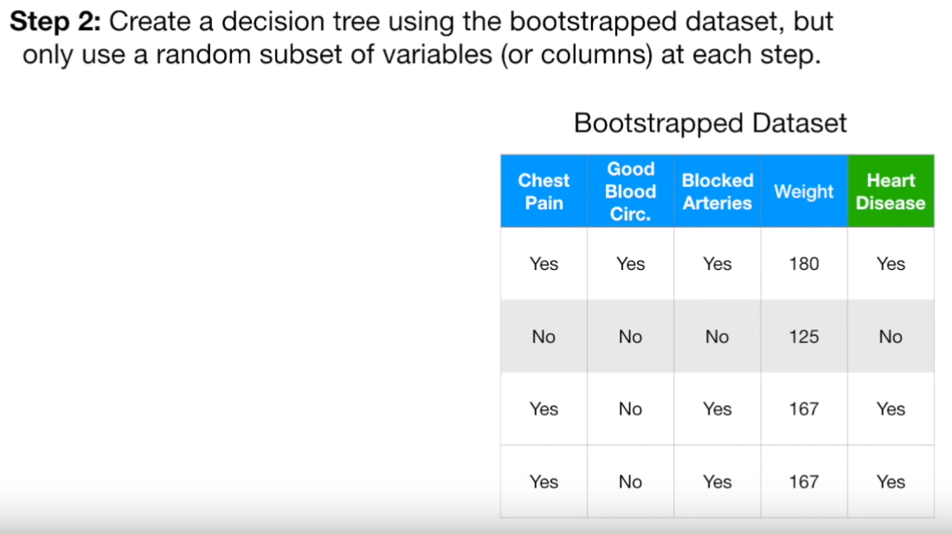
Random Forest: Building the model

Slide 27
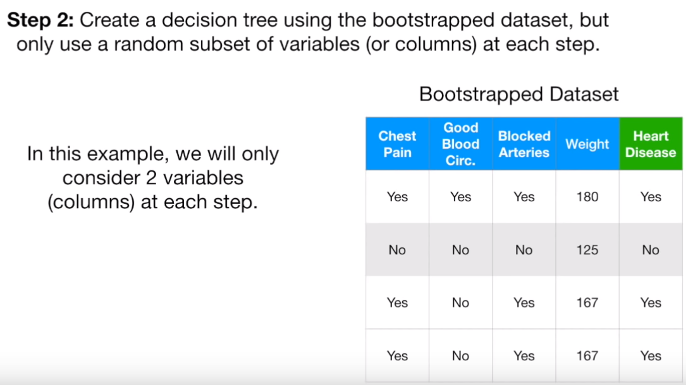
Random Forest: Building the model

Slide 28
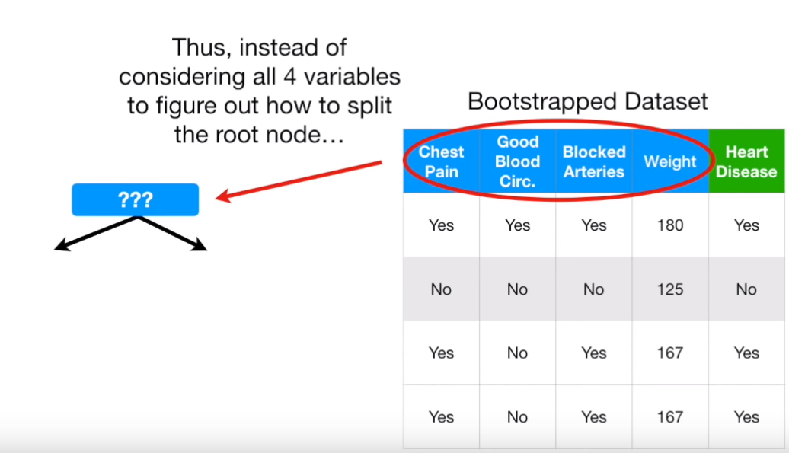
Random Forest: Building the model

Slide 29
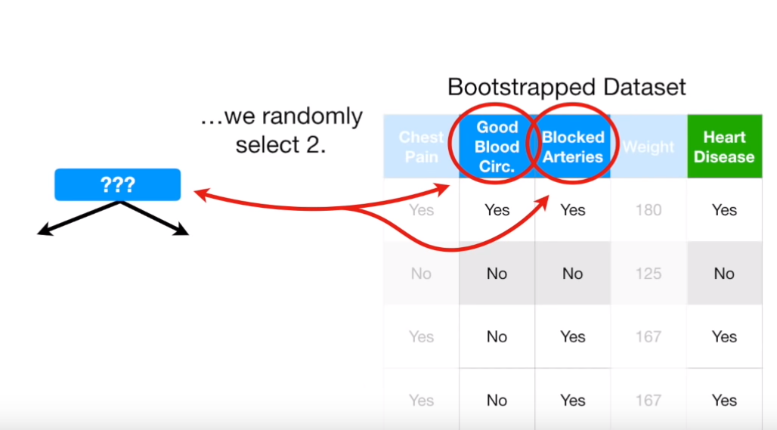
Random Forest: Building the model

Slide 30
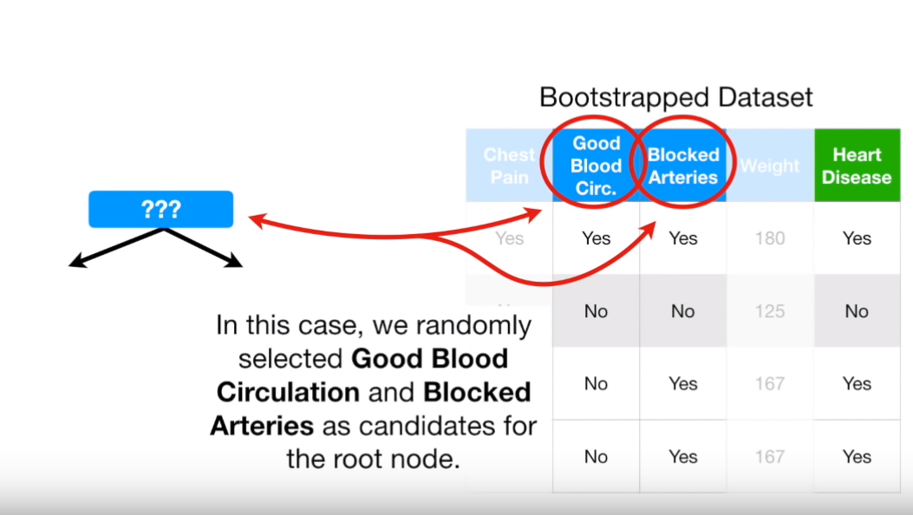
Random Forest: Building the model

Slide 31
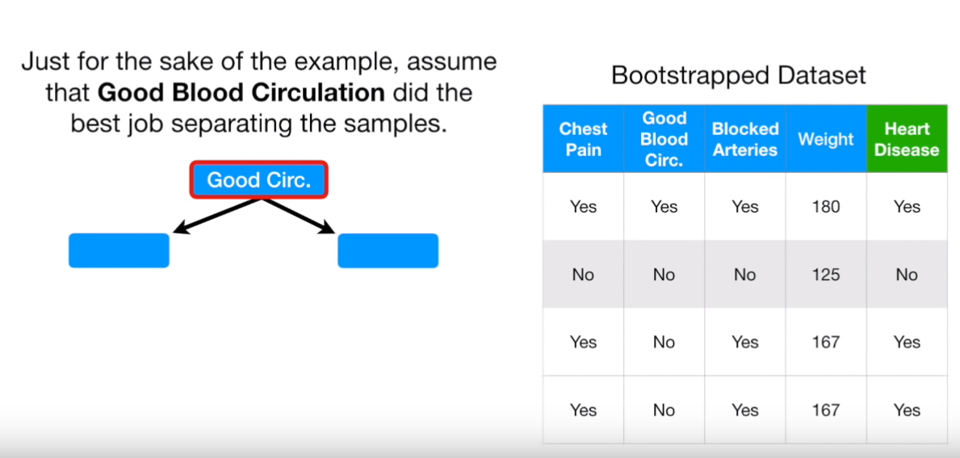
Random Forest: Building the model

Slide 32
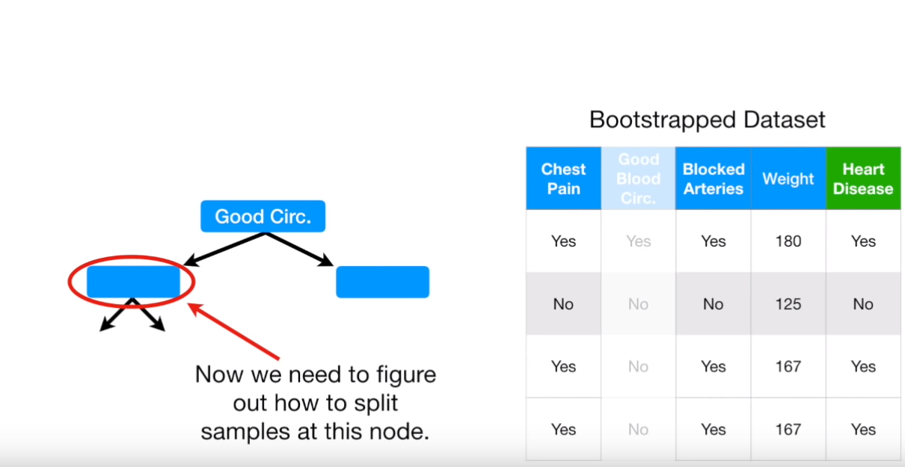
Random Forest: Building the model

Slide 33
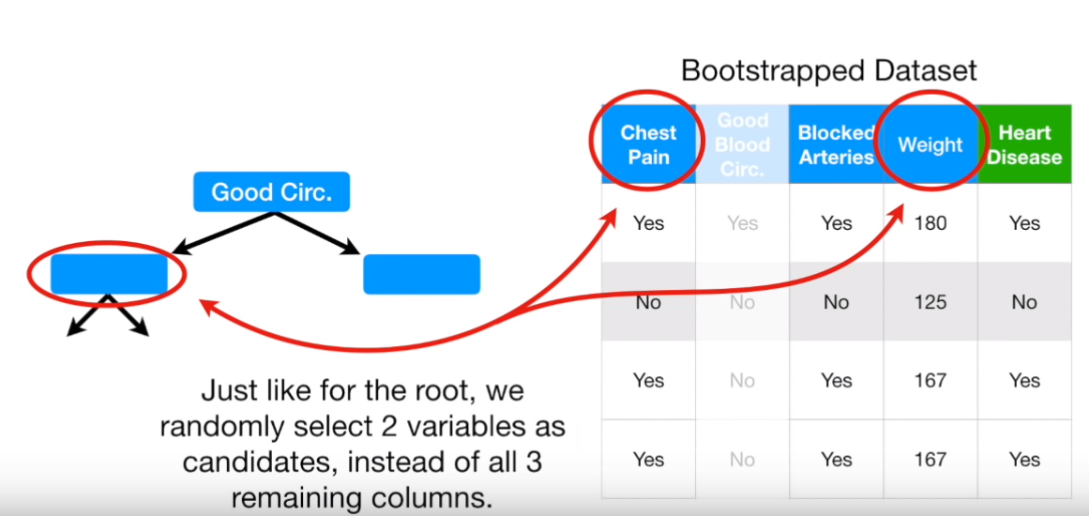
Random Forest: Building the model

Slide 34
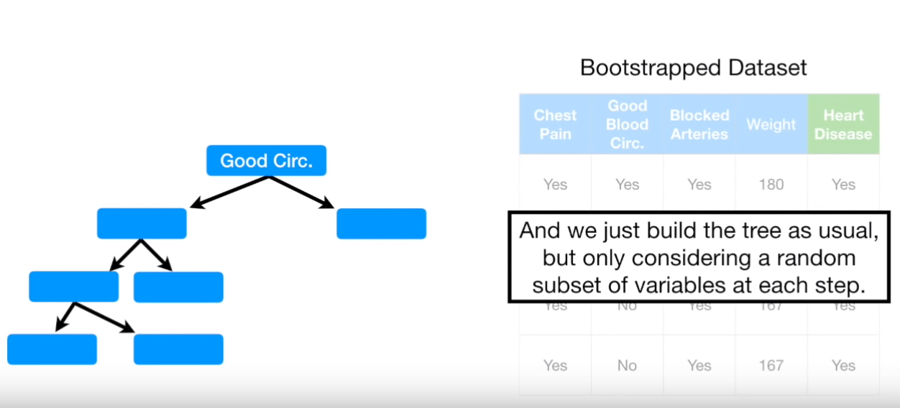
Random Forest: Building the model

Slide 35
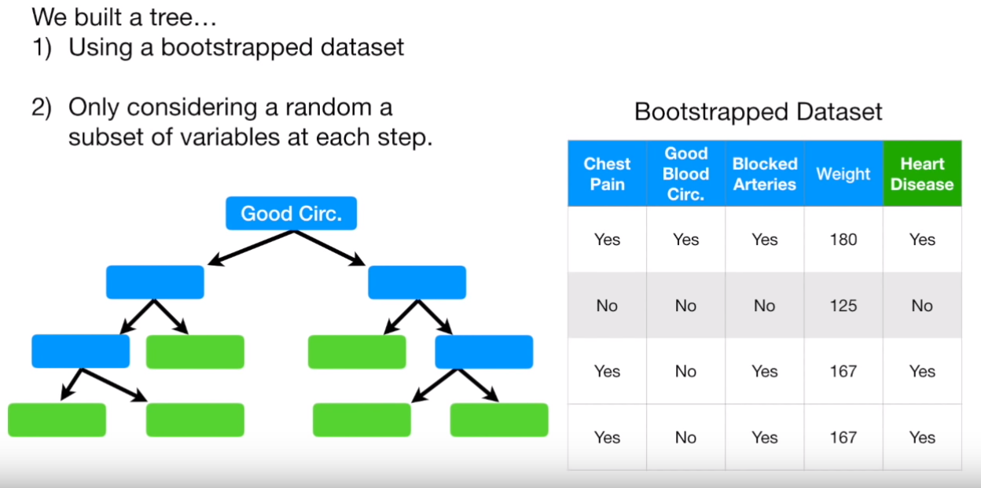
Random Forest: Building the model

Slide 36
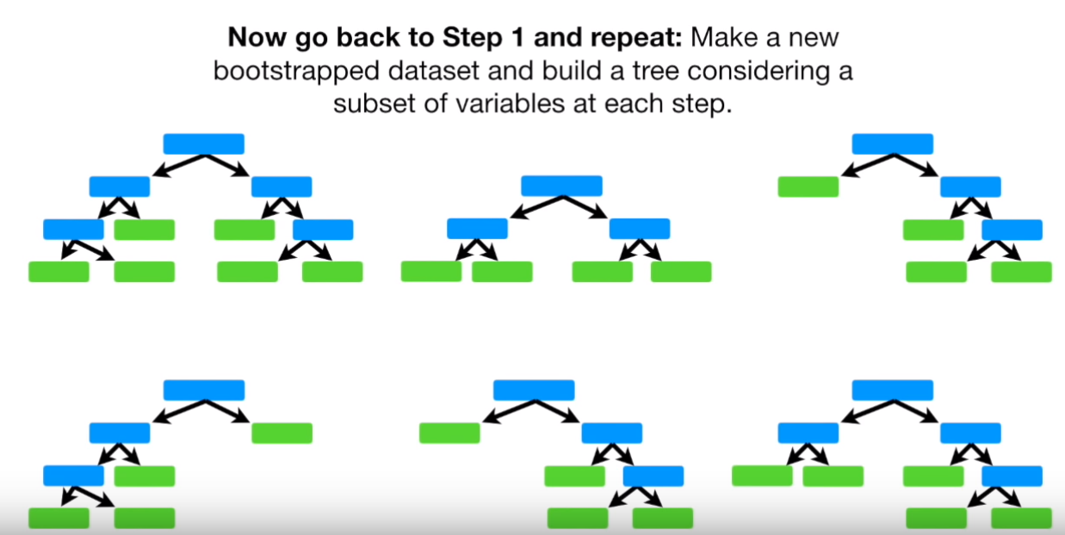
Random Forest: Building the model

Slide 37
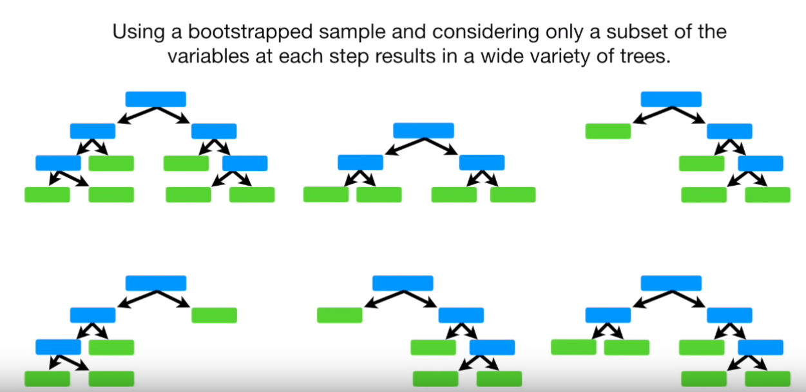
Random Forest: Building the model

Slide 38
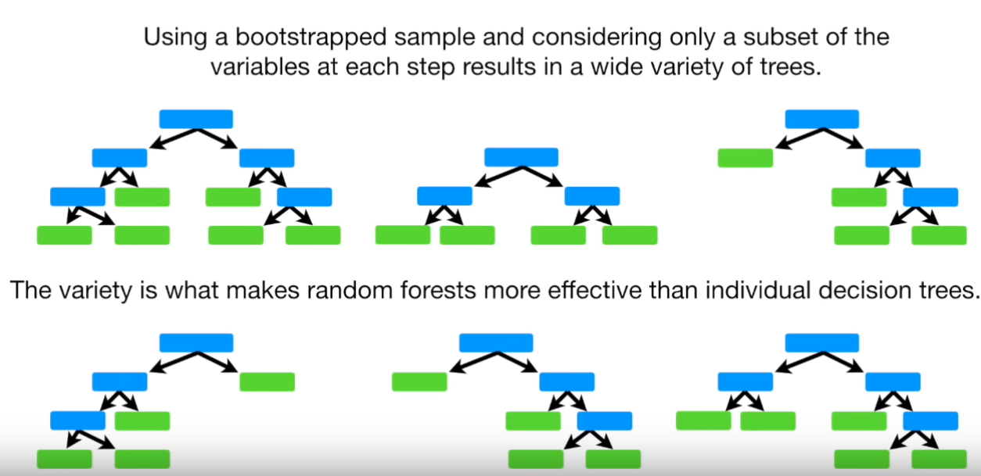
Random Forest: Building the model

Slide 39
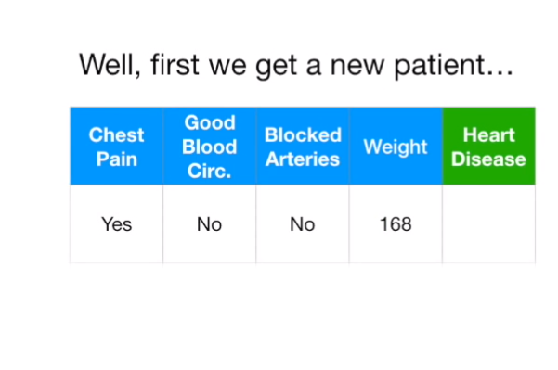
Random Forest: Prediction

Slide 40
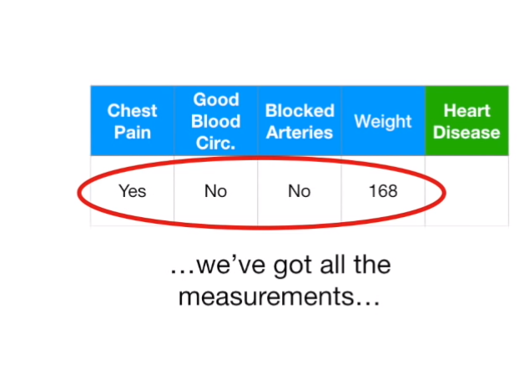
Random Forest: Prediction

Slide 41
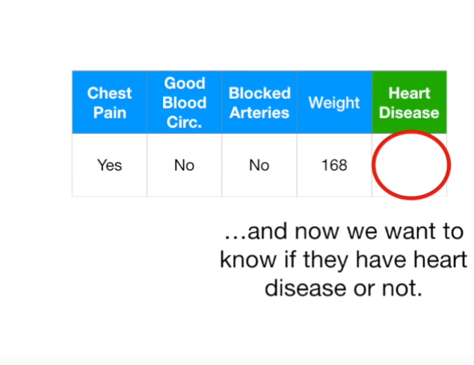
Random Forest: Prediction

Slide 42
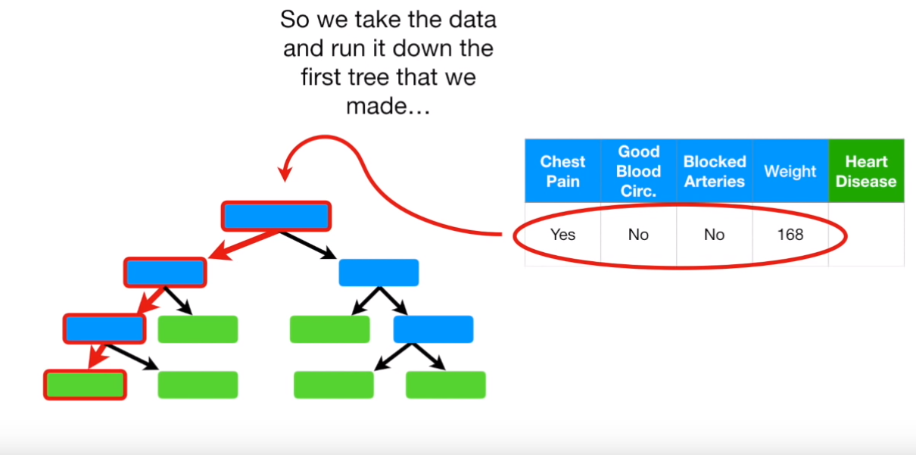
Random Forest: Prediction

Slide 43
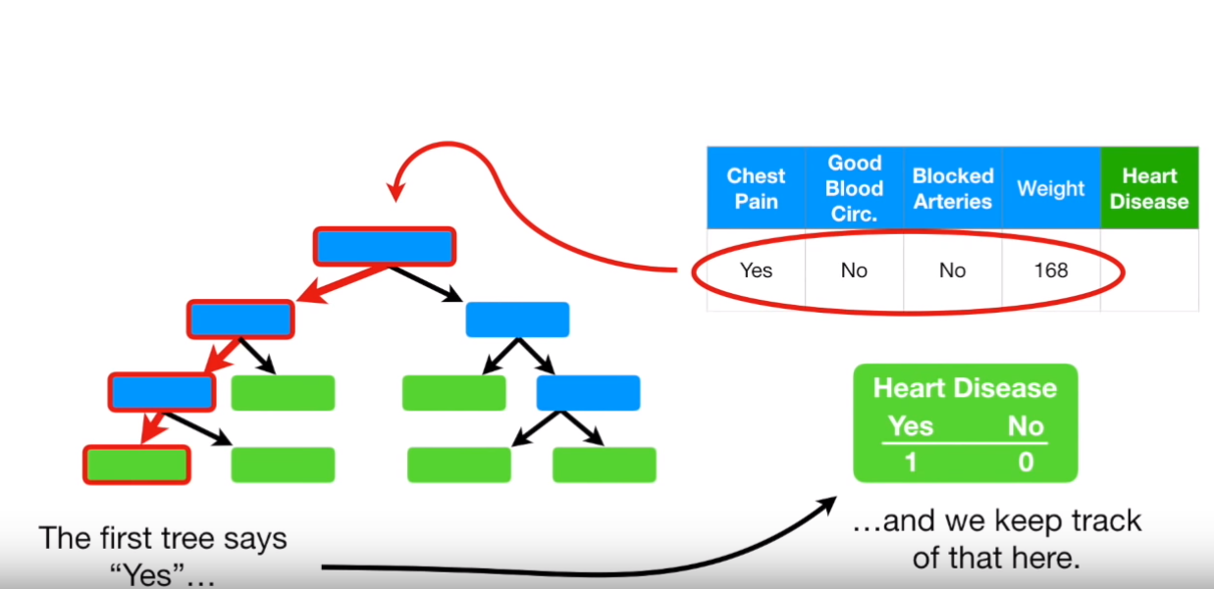
Random Forest: Prediction

Slide 44
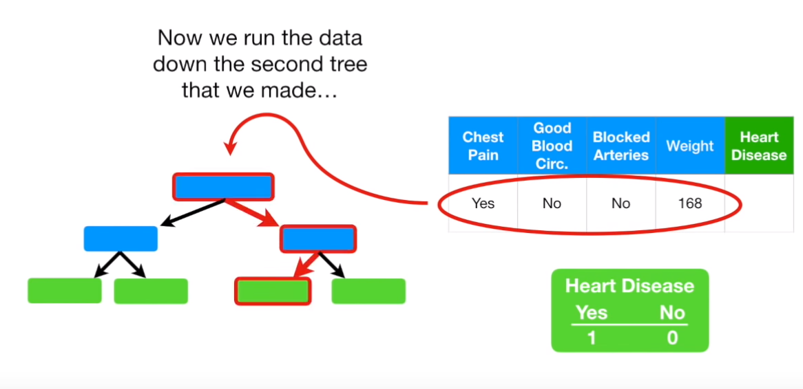
Random Forest: Prediction

Slide 45
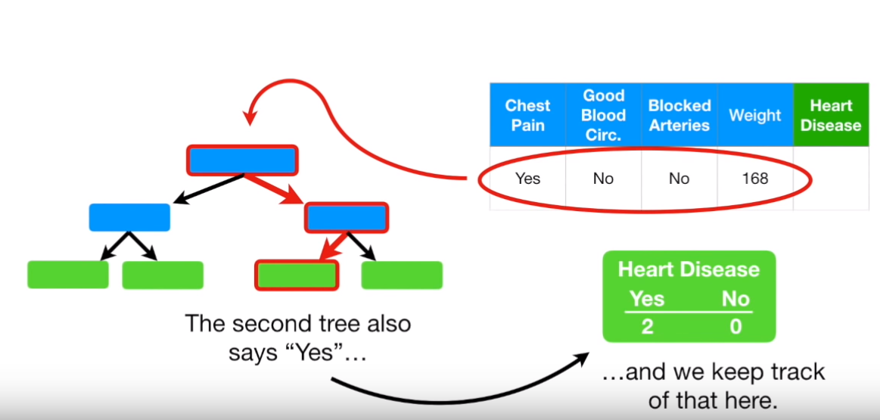
Random Forest: Prediction

Slide 46
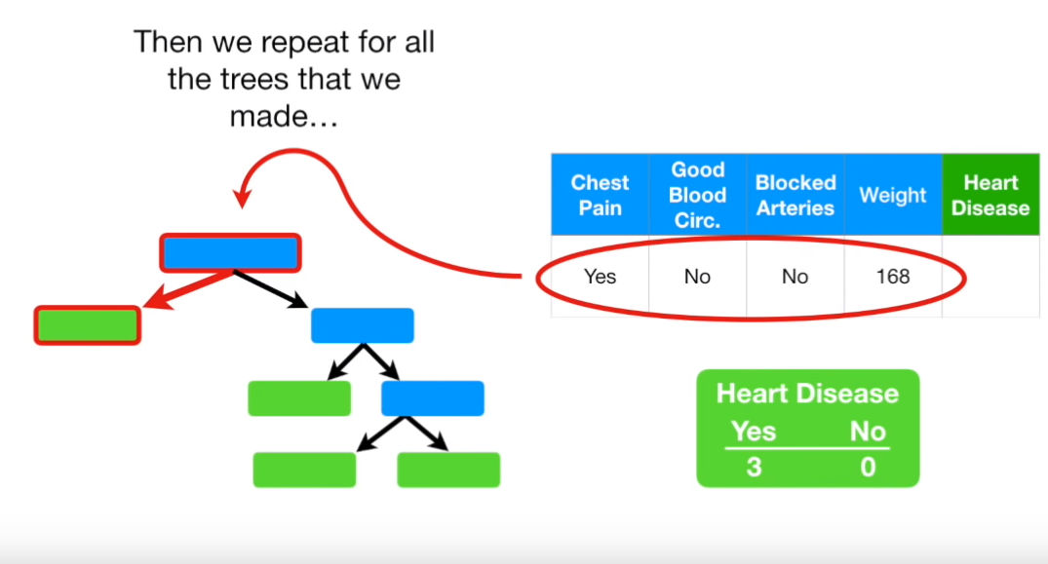
Random Forest: Prediction

Slide 47
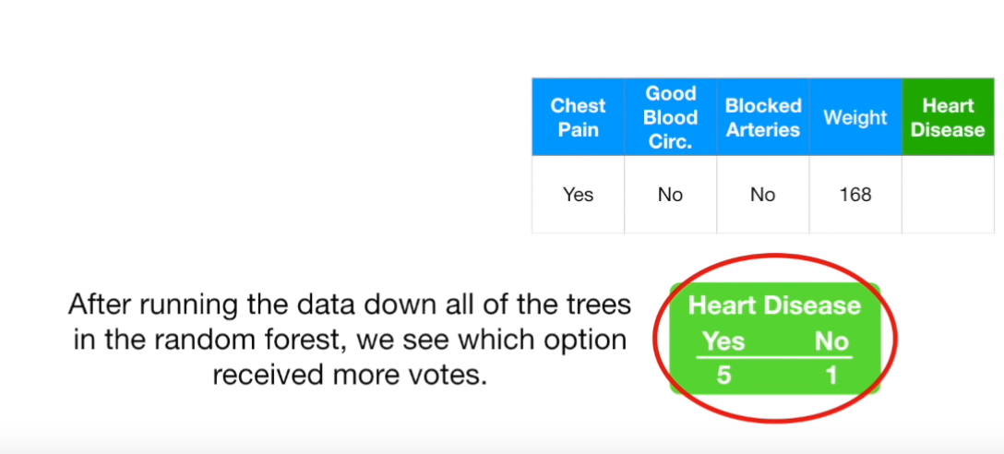
Random Forest: Prediction

Slide 48
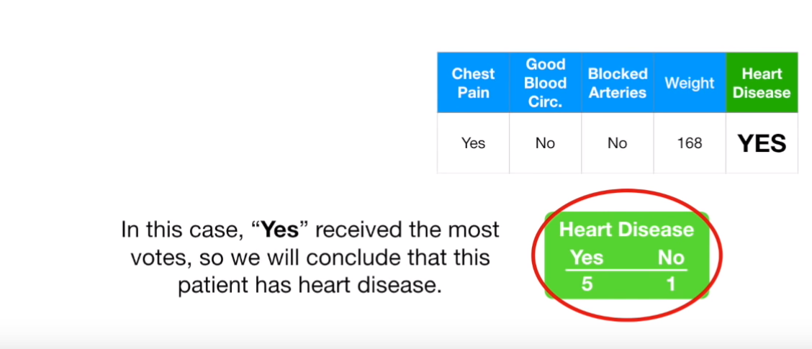
Random Forest: Prediction

Slide 49
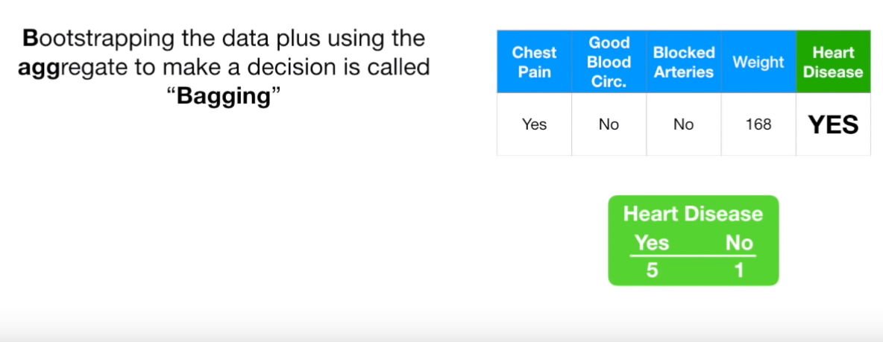
Random Forest: Prediction

Slide 50
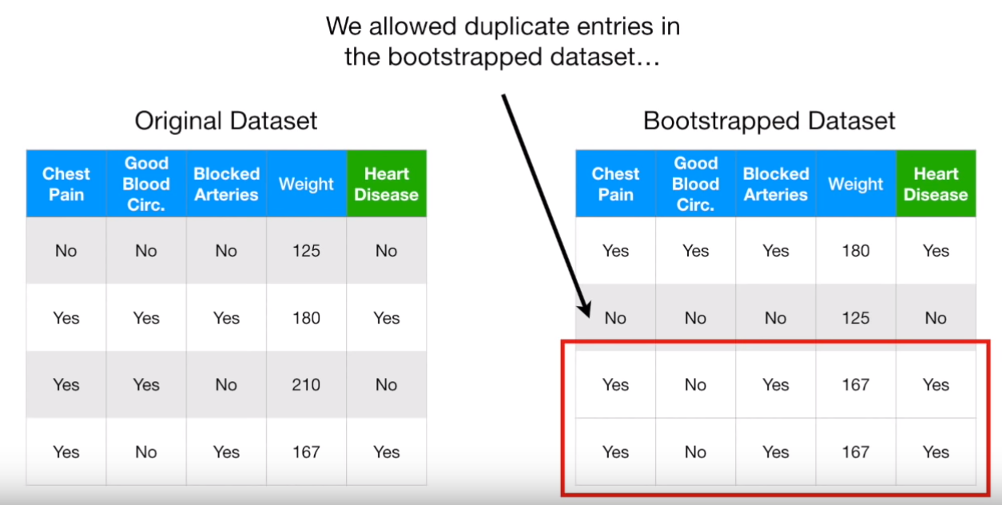
Random Forest: Evaluation

Slide 51
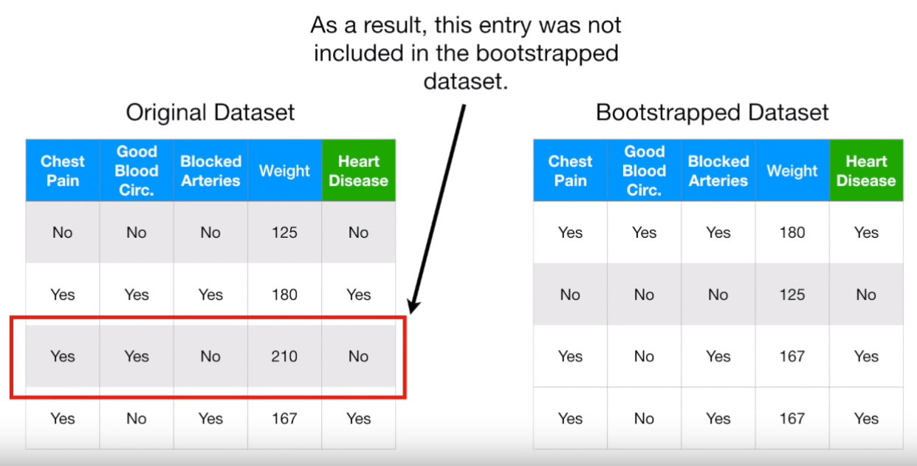
Random Forest: Evaluation

Slide 52
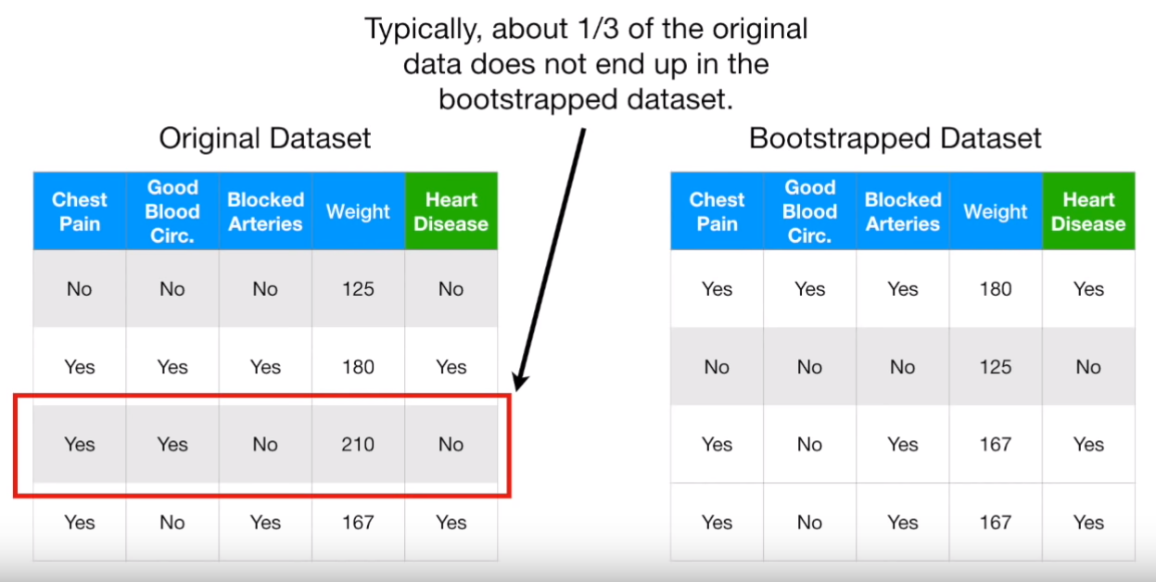
Random Forest: Evaluation

Slide 53
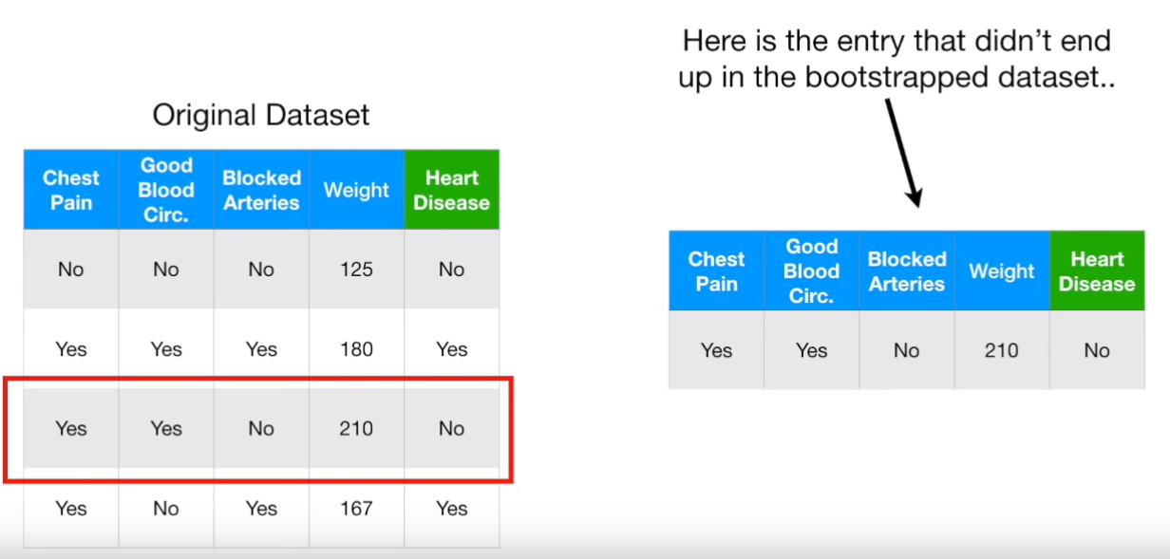
Random Forest: Evaluation

Slide 54
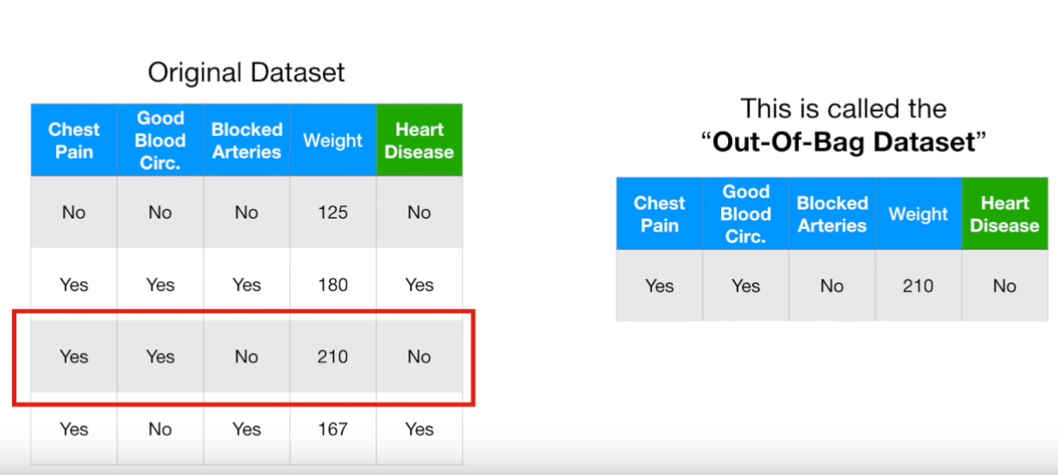
Random Forest: Evaluation

Slide 55
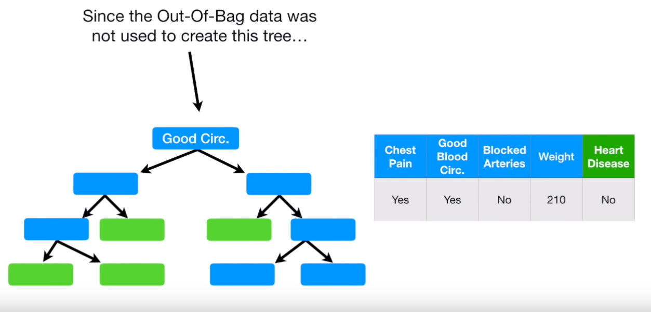
Random Forest: Evaluation

Slide 56
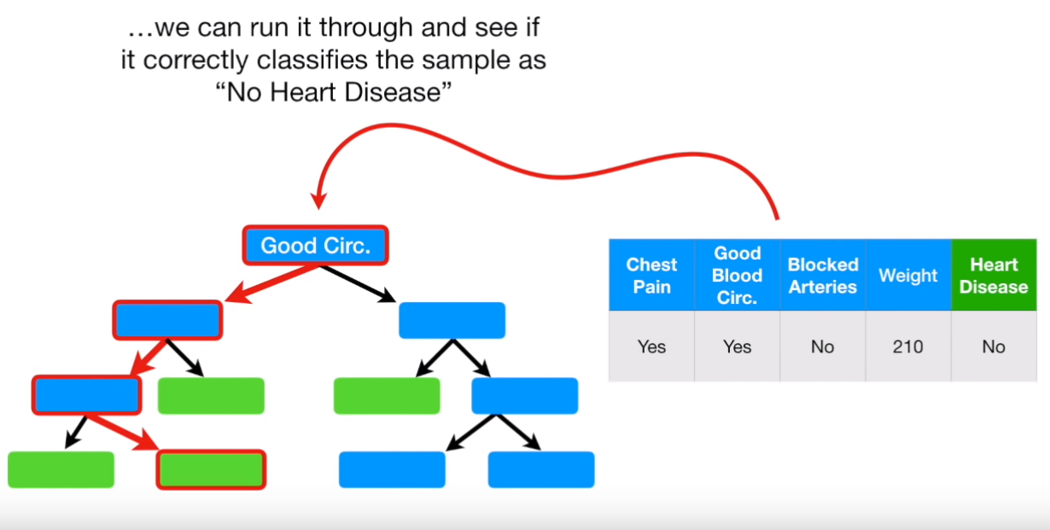
Random Forest: Evaluation

Slide 57
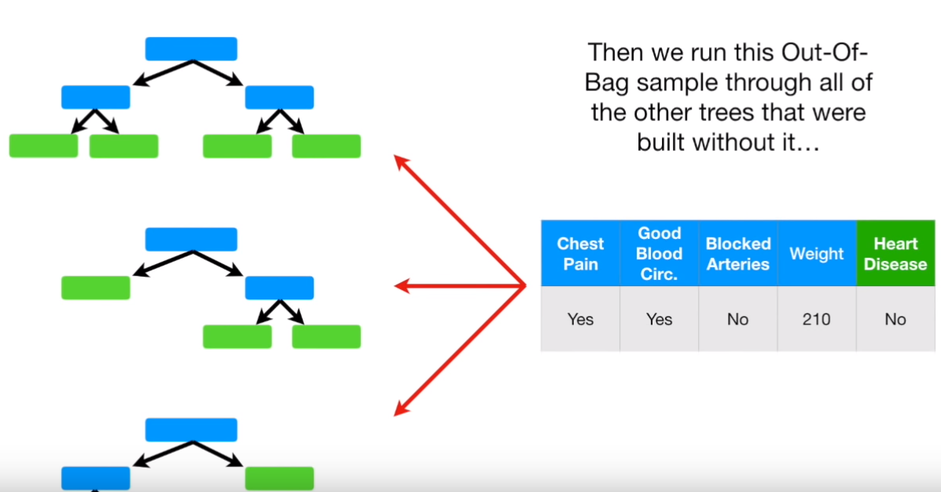
Random Forest: Evaluation

Slide 58
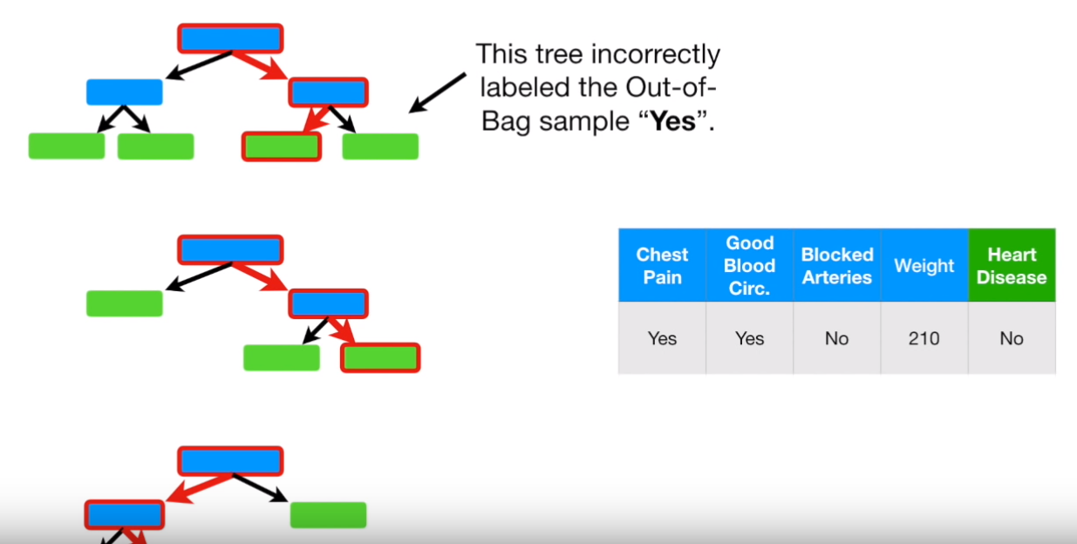
Random Forest: Evaluation

Slide 59
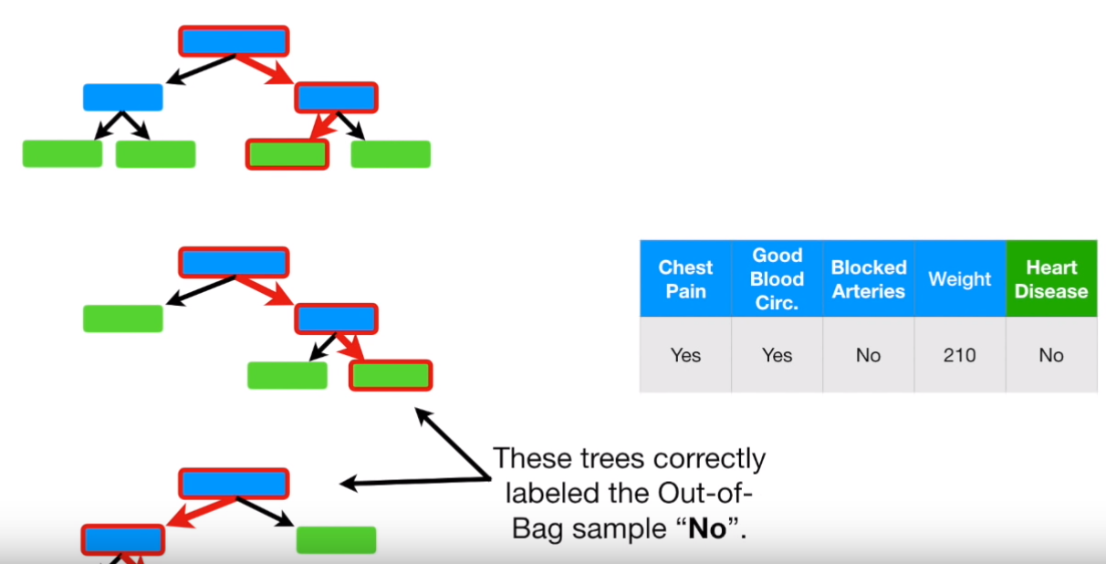
Random Forest: Evaluation

Slide 60
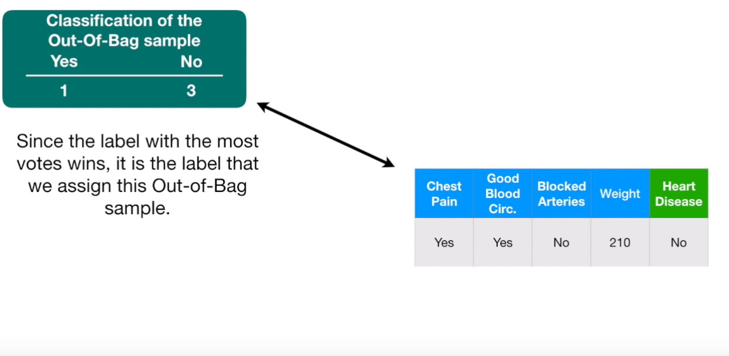
Random Forest: Evaluation

Slide 61
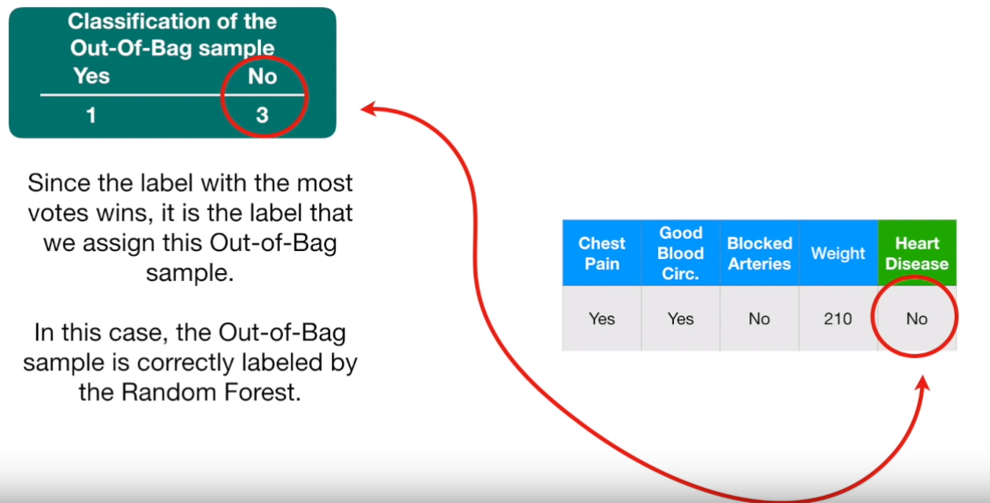
Random Forest: Evaluation

Slide 62
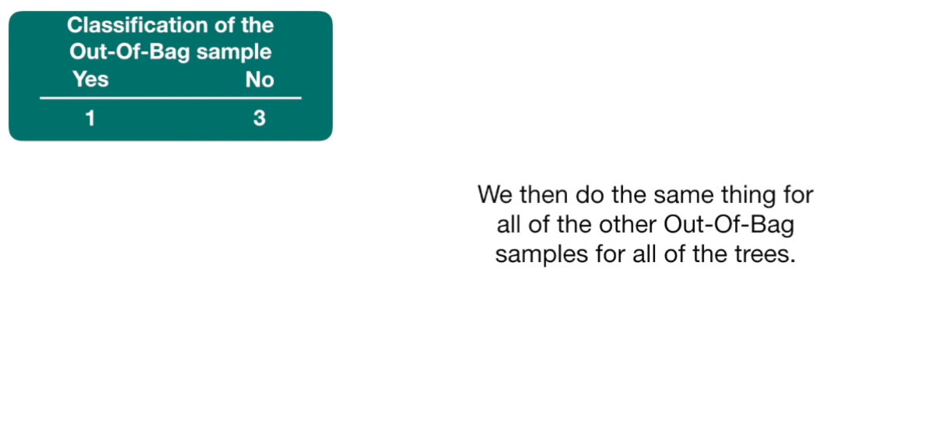
Random Forest: Evaluation

Slide 63
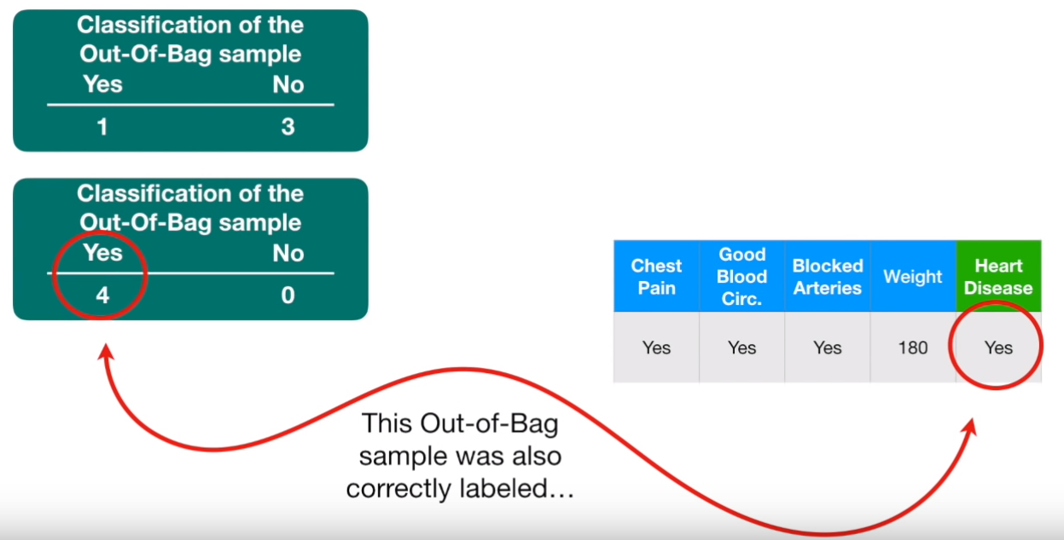
Random Forest: Evaluation

Slide 64

Random Forest: Building the model

Slide 65

Random Forest: Building the model

Slide 66

Random Forest: Building the model

Slide 67

Random Forest: Building the model

Slide 68

Random Forest: Building the model

Slide 69

Random Forest: Building the model

Slide 70

Random Forest: Building the model

Slide 71

Random Forest: Building the model

Slide 72

Random Forest: Building the model

Slide 73

Random Forest: Building the model

